Slide 1

LYRIC GENERATION
WITH RNN
Presented by:
SANDHIYA G
513121104034
Thanthai Periyar Government Institute Of Technology-Vellore

Slide 2
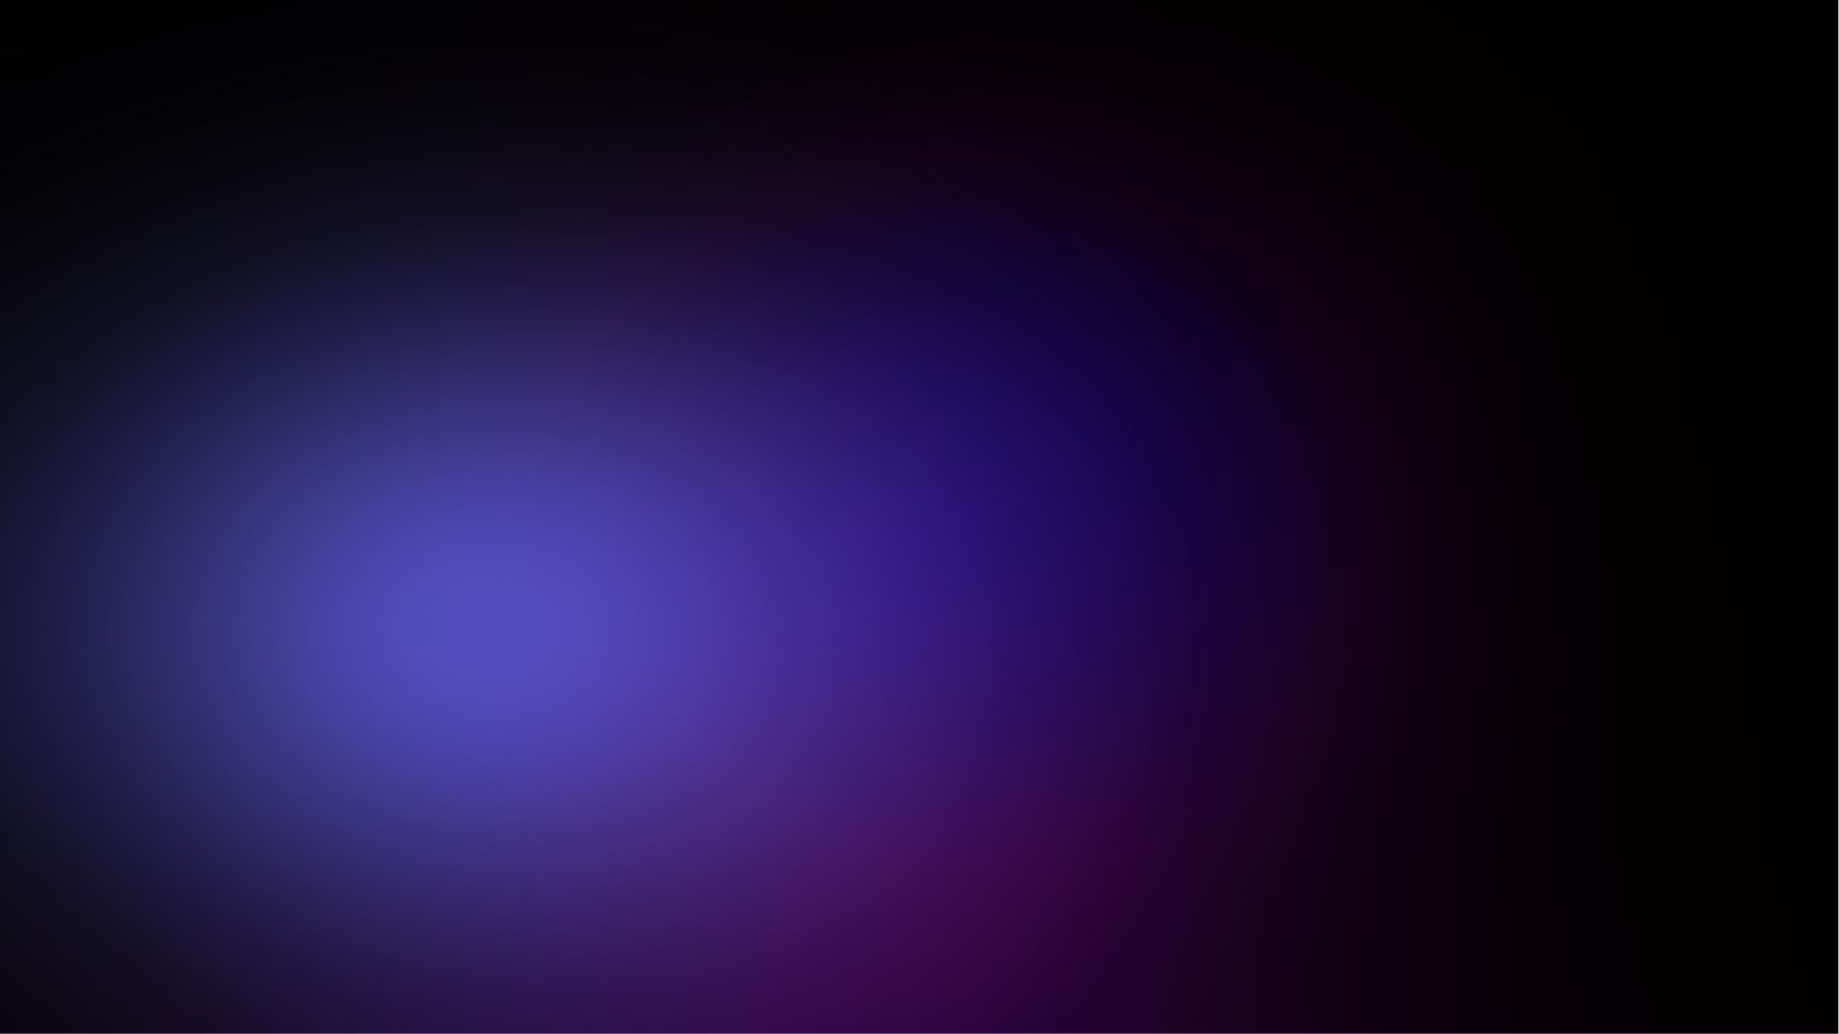
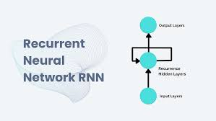
Introduction to Lyric Generation using RNN
RNN
Lyrical Innovation
Recurrent Neural Networks are a type of artificial neural network designed to recognize patterns in sequences of data.
Using RNN to generate creative and original lyrics based on patterns identified in existing music.
Unleashing Creativity
Empowering artists with a new tool to inspire and amplify their artistic
expression.

Slide 3

AGENDA
Introduction
Problem statement
Project overview
Who are end users
Solution and its value proposition
The Wow in solution
Modeling
Result
Conclusion

Slide 4
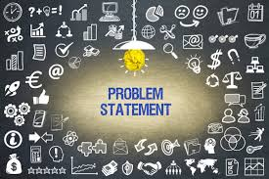
PROBLEM STATEMENT
Develop an algorithm to automatically generate song lyrics using Recurrent Neural Networks (RNNs). The goal is to create a system that can produce coherent and stylistically consistent lyrics resembling those written by human songwriters. This involves training the RNN model on a dataset of existing song lyrics and then using it to generate new lyrics based on given input prompts or seed sequences. Challenges include capturing the nuanced patterns, themes, and emotions present in human-written lyrics, while ensuring the generated lyrics are original and artistically meaningful..

Slide 5

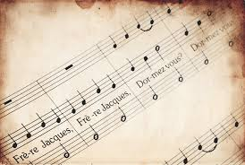
PROJECT OVERVIEW
.
This project aims to develop an algorithm using Recurrent Neural Networks (RNNs) to generate song lyrics automatically. It involves data preprocessing, model training, text generation, and evaluation. The dataset of song lyrics is cleaned and tokenized for training. An RNN model is then trained to learn patterns in the lyrics. Using this model, new lyrics are generated based on input prompts. Evaluation metrics assess the quality of the generated lyrics, and the trained model is deployed for interactive lyric generation or integration into other applications.

Slide 6




WHO ARE THE END USERS
Professionals
Students
Artists
Content
Creators
Individuals in creative industries seeking inspiration
Learning about language and the creative process
Looking for new ways to express their emotions through lyrics
Seeking engaging and original content for their audience

Slide 7
SOLUTION AND ITS VALUE PROPOSITION
Our solution is an innovative AI-powered song lyric generation system using advanced Recurrent Neural Networks
(RNNs). It learns complex patterns from extensive song lyric datasets, allowing it to autonomously produce original,
high-quality lyrics.
Efficiency
Cost-Effectiveness
Creative Inspiration
Innovative technology streamlines processes and saves time.
Provides high value at a competitive price point.
Provides songwriters,musicians,and content creators with inspiration by generating new song ideas.

Slide 8
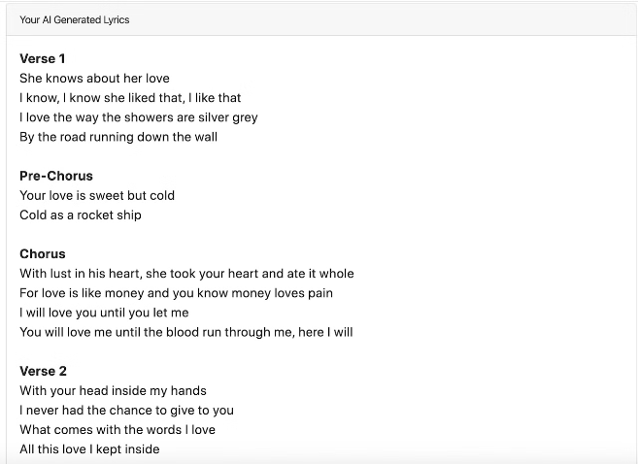
THE WOW IN SOLUTION
The wow factor in our solution is its utilization of Recurrent Neural Networks (RNNs) to autonomously generate compelling song lyrics. Through the power of RNNs, our model captures intricate patterns and nuances in lyrical compositions, enabling it to produce coherent and engaging lyrics across various musical genres.

Slide 9

MODELING WITH RECURRENT NEURAL NETWORKS
Data Gathering
1
Collect and curate diverse and large-scale lyric datasets.
2
Training the RNN
Use LSTM architecture to learn sequential patterns and generate new lyrics.
Evaluating Results
3
Assess generated lyrics for coherence, creativity, and relevance.

Slide 10

RESULT
The result of our solution is a powerful model trained on a diverse dataset of song lyrics, capable of autonomously generating compelling and coherent new lyrics. Through the utilization of Recurrent Neural Networks (RNNs) and deep learning techniques, our model captures the essence of various musical styles and genres, producing lyrics that are both innovative and evocative. Artists can leverage this tool to spark inspiration, streamline the songwriting process, and explore new creative avenues. Ultimately, the result is a transformative approach to music composition that empowers artists to push the boundaries of their craft and create impactful and resonant music.

Slide 11
CONCLUSION
1. Data Exploration and Preprocessing: We began by loading the dataset, exploring artist distributions, and engineering features like character and word counts.
2. Visualization:We used seaborn to visualize song length distributions and wordcloud to identify frequent words in lyrics.
3. Model Building: Constructed an LSTM neural network using Keras, tailored for sequence generation tasks like song lyric generation.
4. Training and Evaluation: Trained the model using the Adamax optimizer and visualized training history to assess model performance.
5. Text Generation: Implemented a text generation function using the trained model to generate song lyrics based on a given seed text.
The project showcases the power of deep learning in automating song lyric generation, providing artists with a tool to streamline their creative process and inspire new musical compositions.

Slide 12
THANK
YOU

